Slide 1
Introduction to Data Science with Python
Chapter 0
July 28, 2023

Slide 2
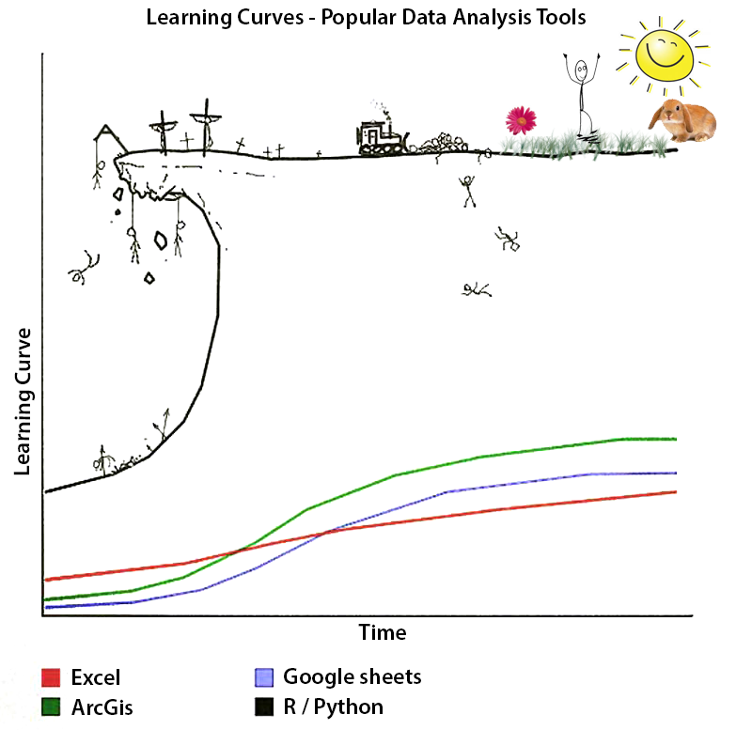

Slide 3
This course

Slide 4
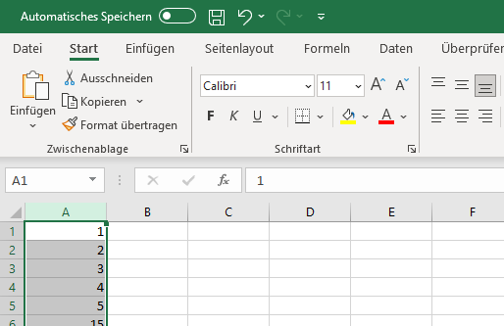
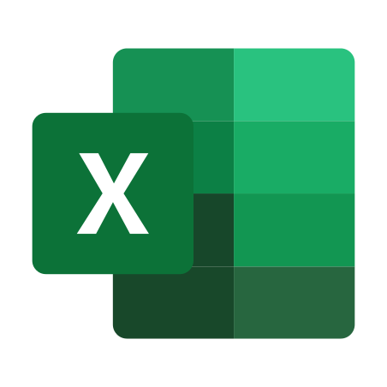

Excel vs Python
Select data
Click on buttons :)
Write code in editor
Execute code with Python
Result will be returned
data = pd.read_csv(file)
mean = data.mean()
print(mean)

Slide 5
A General Purpose Coding Language
Automation
Web Development
Data Science / Machine Learning
Desktop Apps
Network Servers

Slide 6
Software

Slide 7

Google Colab
Write and execute code
Accessed via Browser (runs on Google Servers)
No pre-configurations necessary
Independent of your local machine
Jupyter Notebook format heavily used in data science community

Slide 8
Data science life cycle

Slide 9
We‘ll walk you through the data science lifecycle and introduce the tools for each step
Visualize
Import
Tidy
Transform
Communicate
Model
Understand
Program

Slide 10
Let‘s dive in!

Slide 11

Based on datacience.org

Slide 12
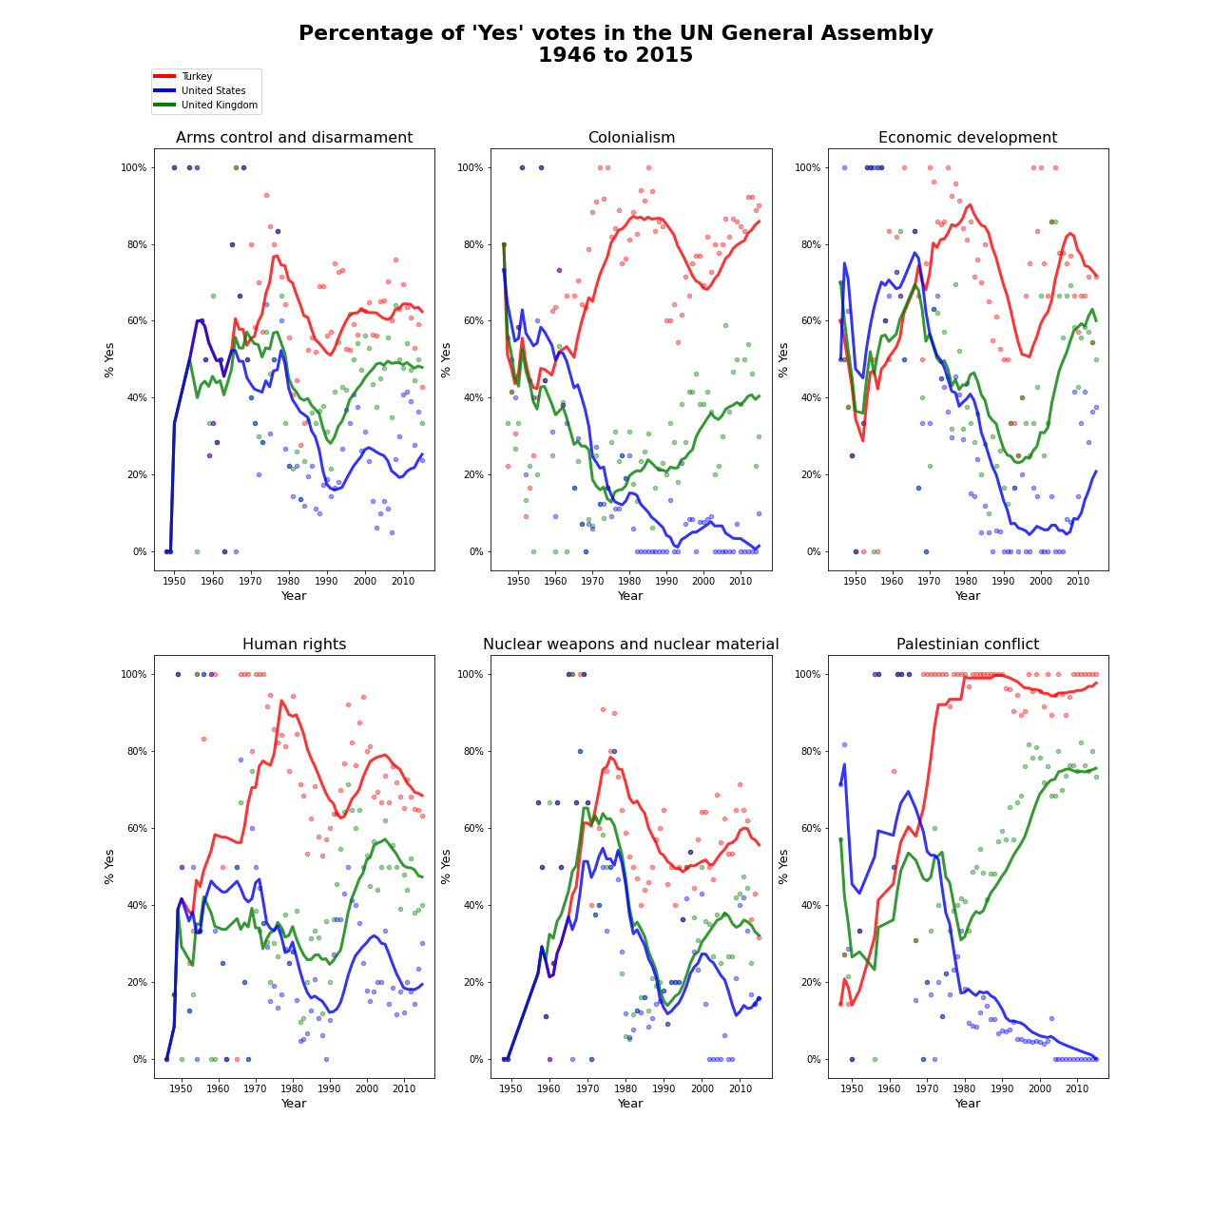

Slide 13
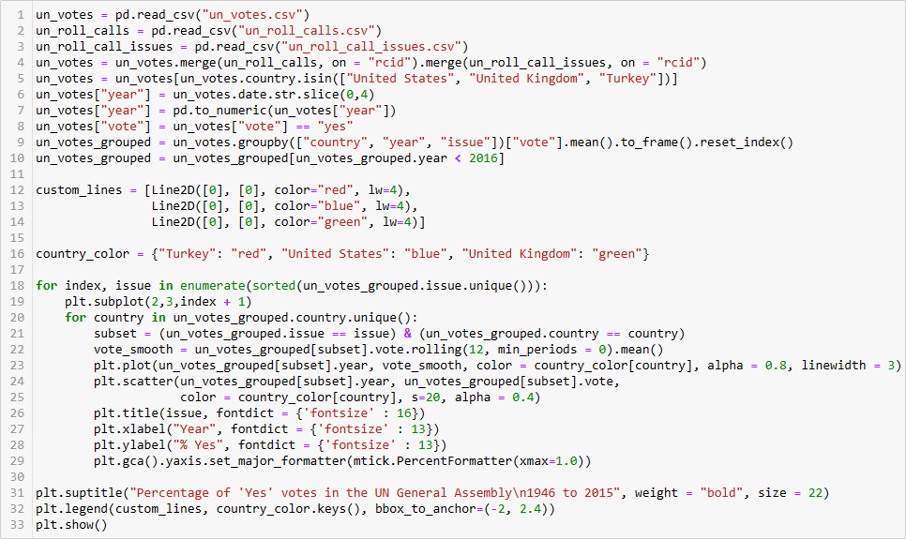

Slide 18
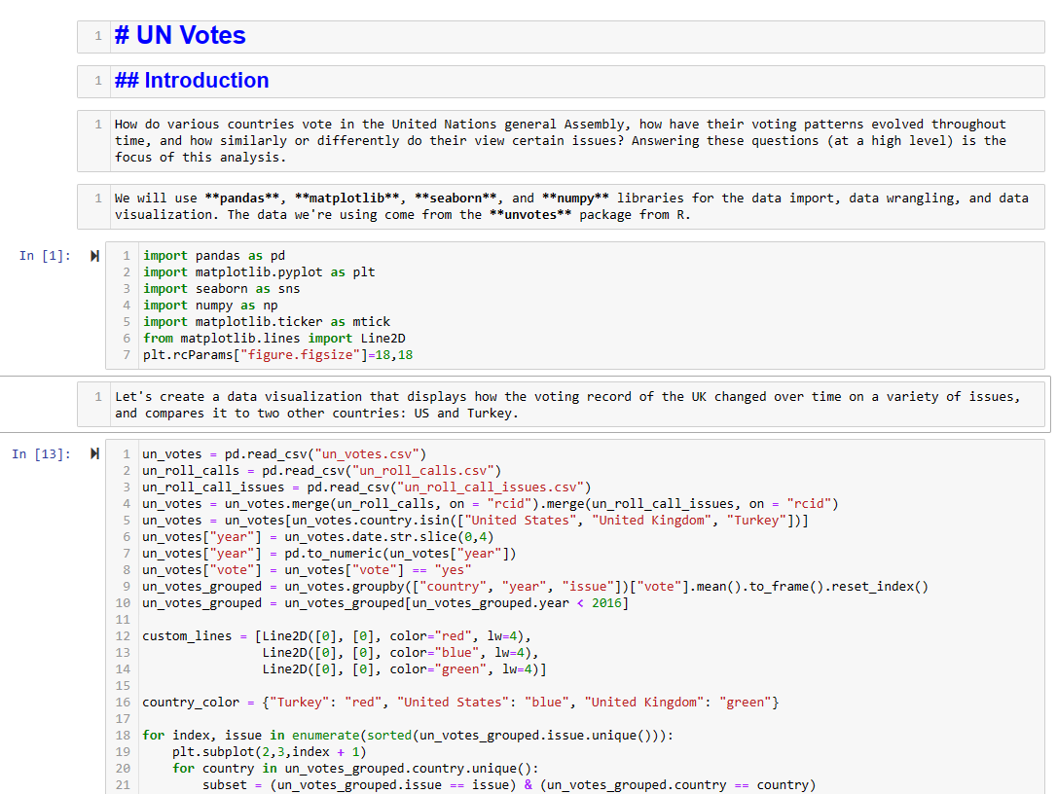
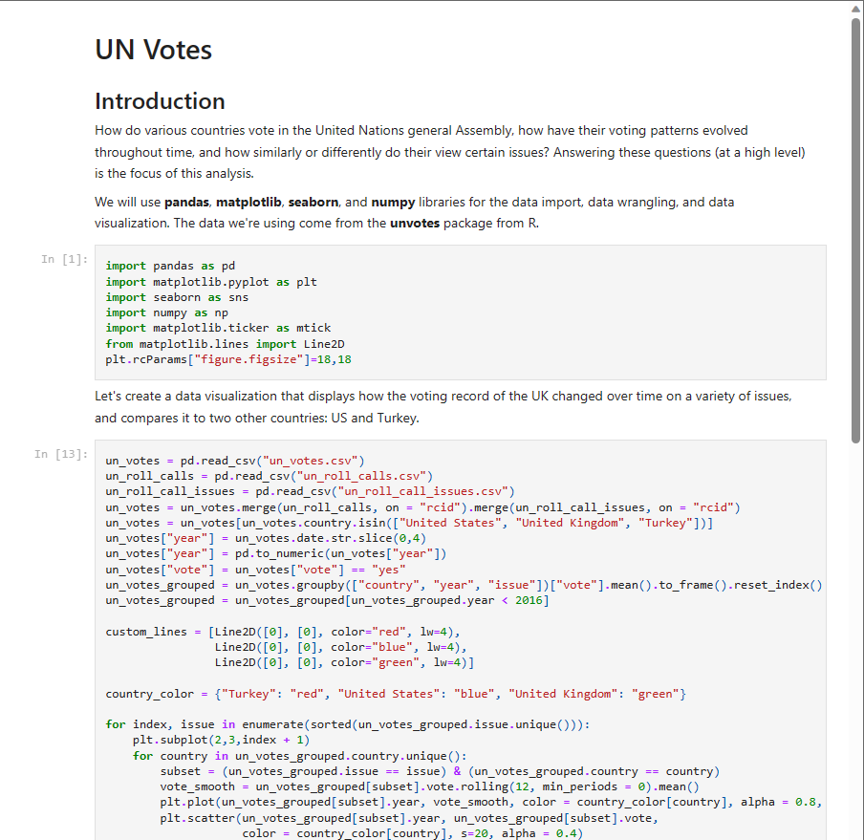

Slide 19
Is it possible to learn all that in this course?
Yes, if you‘re actively coding along and invest some time.
We‘ll go through every step in this course:
1. Chapter
2. Chapter
3. Chapter
Python Fundamentals
Data Wrangling & Simple visualizations
Visualizations & Modelling
Basic concepts, Variables, basic data structures, functions
How to process data with pandas and visualize it with matplotlib
More plots with matplotlib and seaborn and an introduction to modelling

Slide 20


Structure of the course
For each of 3 Chapters:
Introduction of new concepts
Your turn! - Small exercises (~5 minutes)
Live coding
Contact Us!
kraft.thilo.g@gmail.com &
jan.bischoff@tech-academy.io

